Slide 1
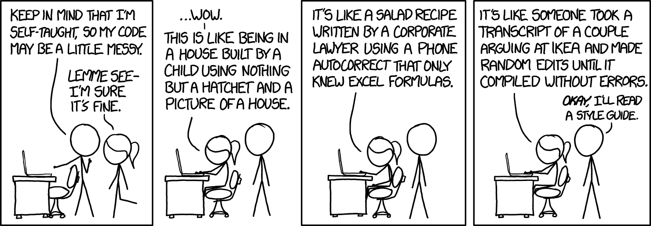
1.7:
Reading and Writing to .csv files
ICS 3U/3C
David Beilby
Zeyad Nasr
Thomas Brittain

Slide 2
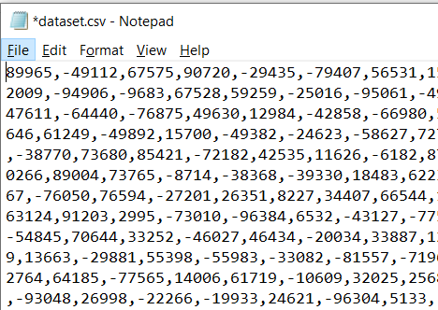
.csv files
CSV stands for comma separated values.
A file type consisting of values of data, separated by commas and endlines (\n).
May be written as a .txt file as well, so long as the formatting stays the same.

Slide 3
.csv files
The methods for .csv file manipulation are the same as .txt file manipulation. Remember these methods for removing the \n and comma values from each line.
.rstrip(“\n”) is a method of a string that replaces the end of a string if it exists. This will remove all linebreaks from the .csv import.
.rsplit(“,”) splits a string at specified positions into a list. This will separate the values of the .csv file into a list without any commas.

